Slide 1
Chapter 7
Virtual Memory

Slide 2
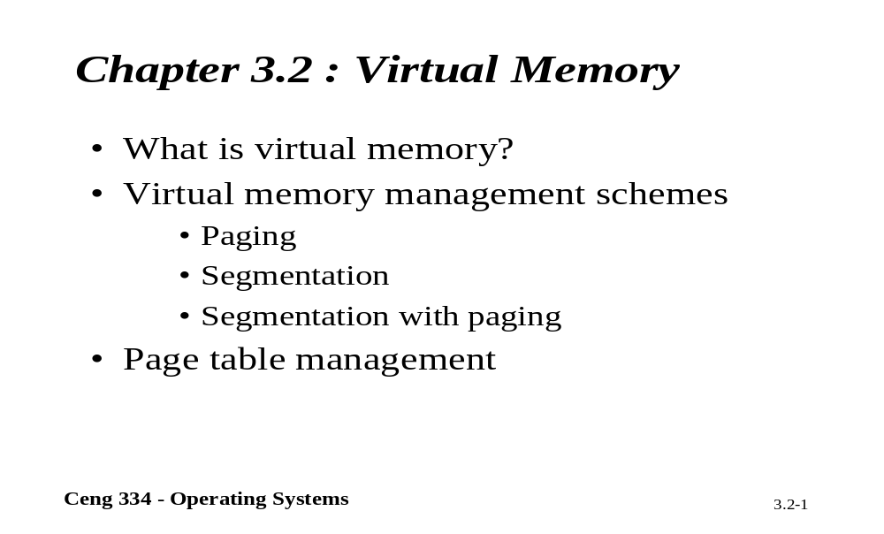
Chapter 3.2: Virtual Memory

Slide 3
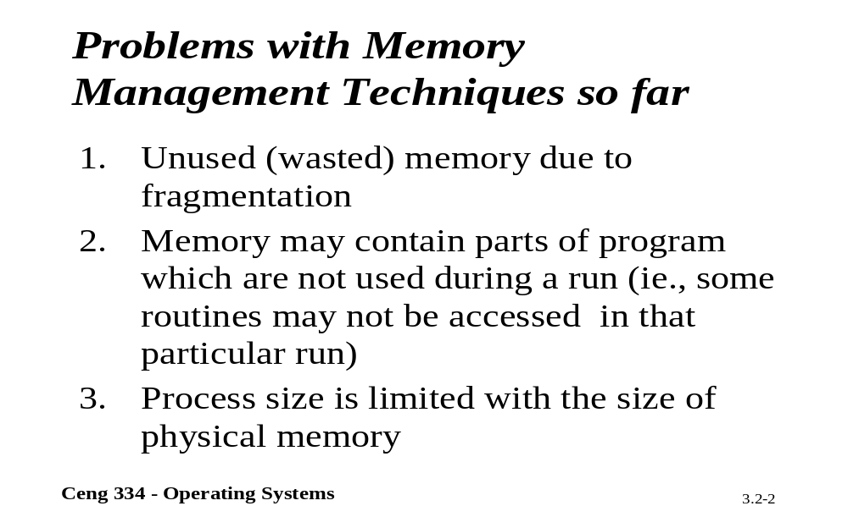
Problems With Memory Mang.

Slide 4
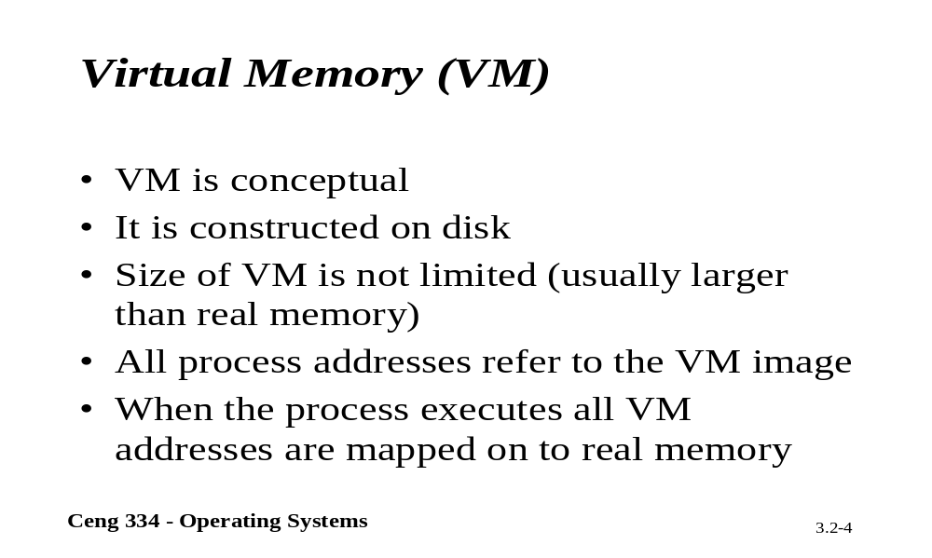
Virtual Memory

Slide 5
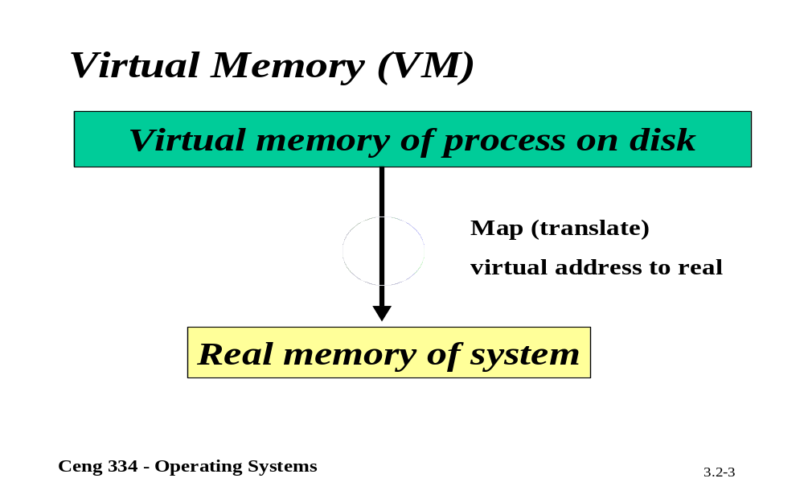
Virtual Memory

Slide 6

Virtual Memory
Paging (1)
The position and function of the MMU

Slide 7
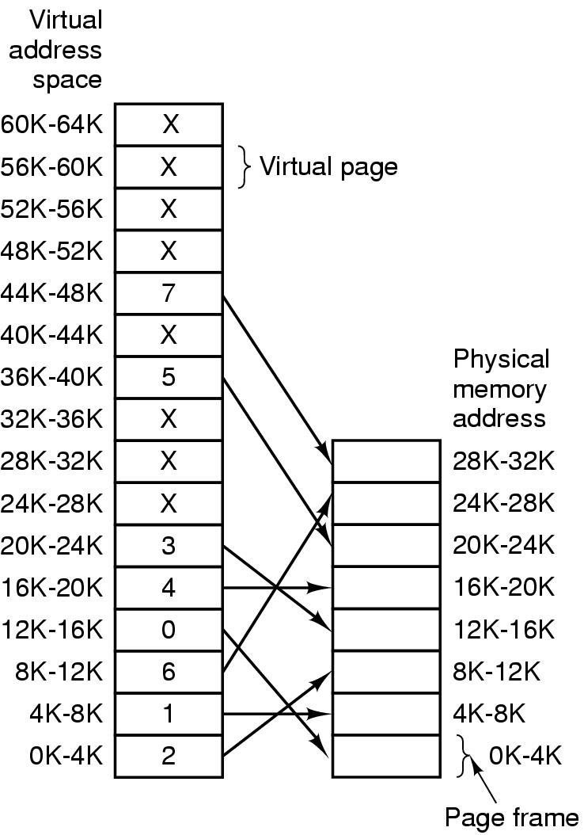
Paging (2)
The relation between
virtual addresses
and physical
memory addres-
ses given by
page table

Slide 8

Page Tables (1)
Internal operation of MMU with 16 4 KB pages

Slide 9
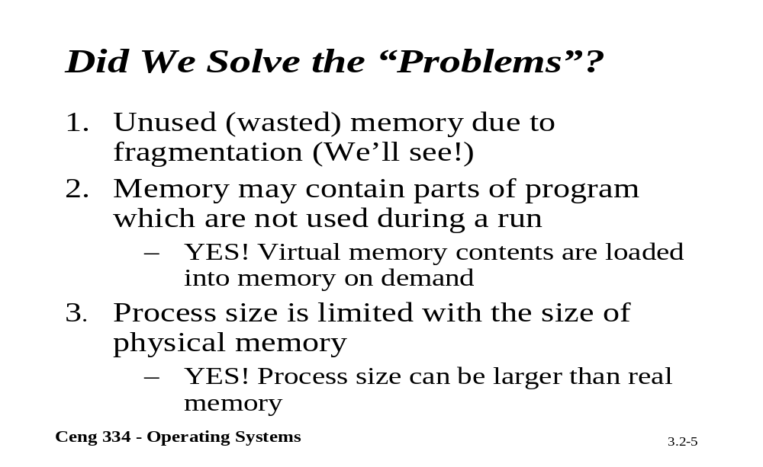
Problems Solved?

Slide 10
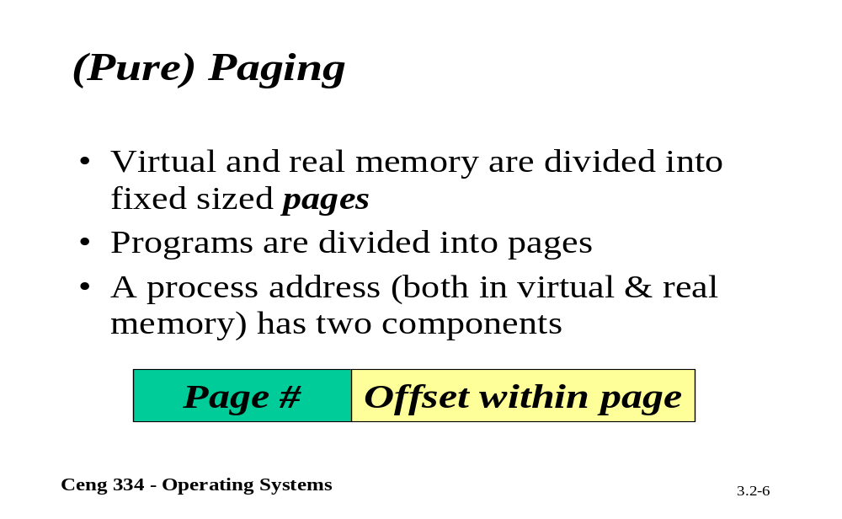
Pagging

Slide 11
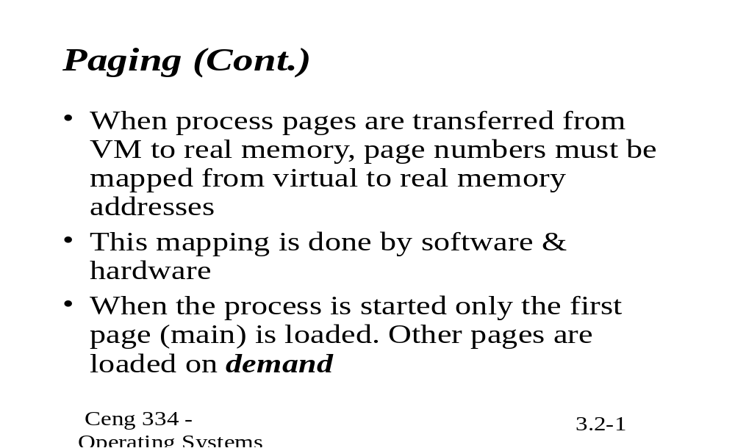
Pagging

Slide 12
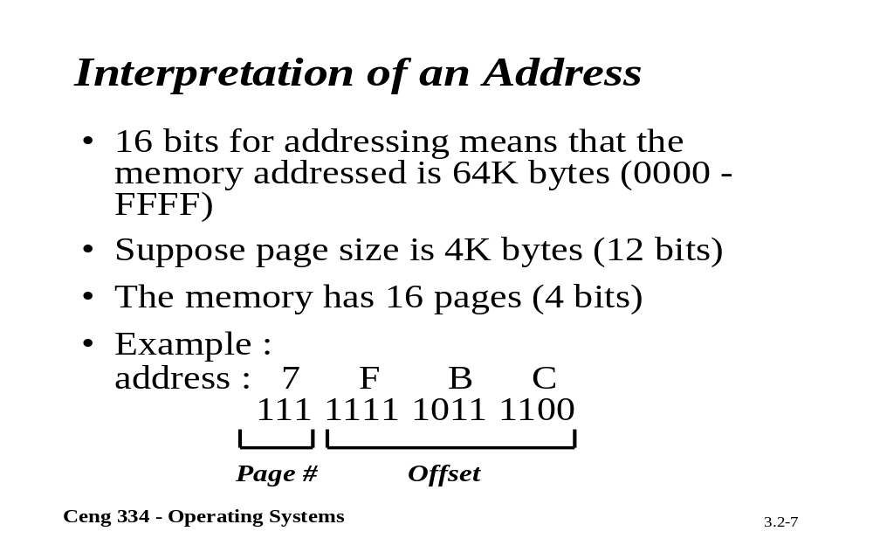
Interpretation Of an Address

Slide 13
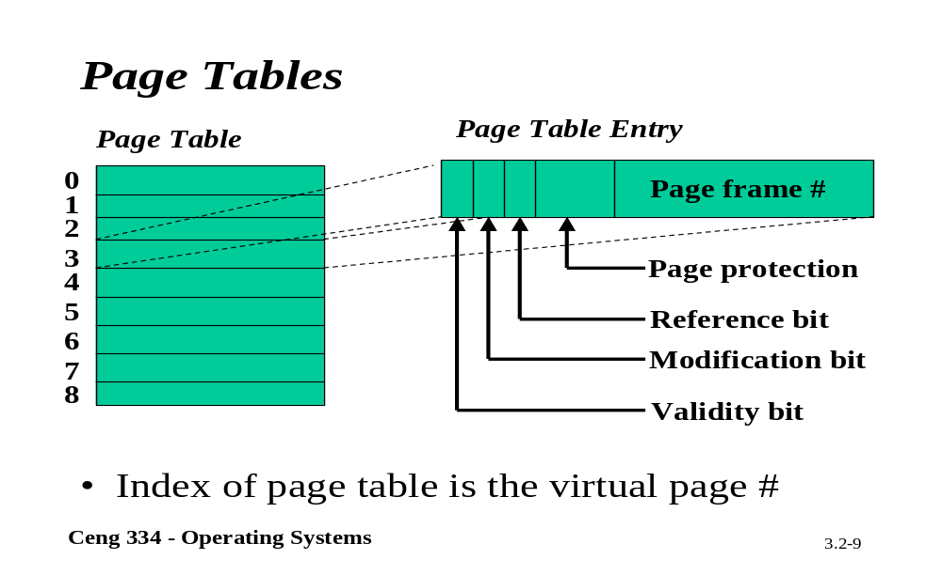
Page Tables

Slide 14
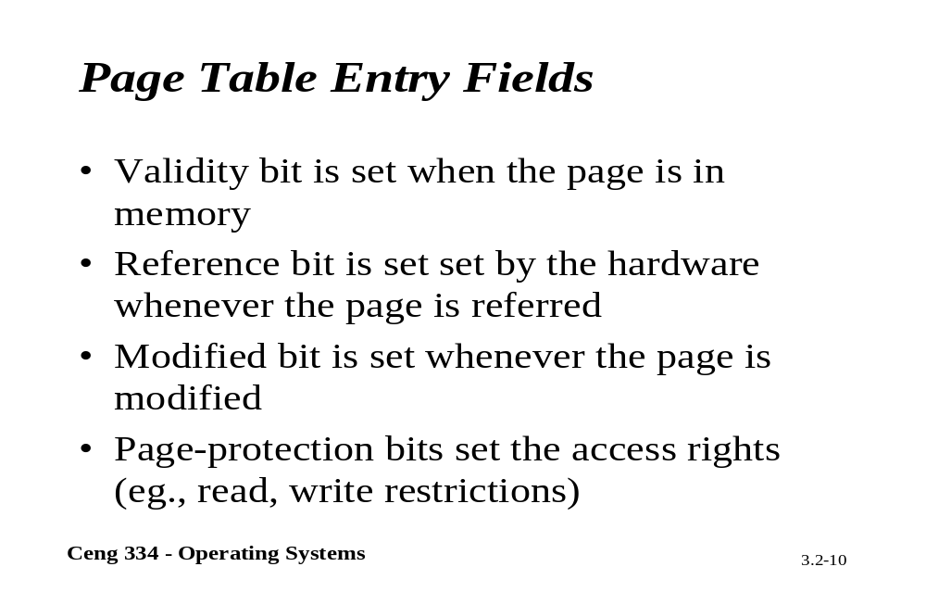
Page Table Entry Fields

Slide 15
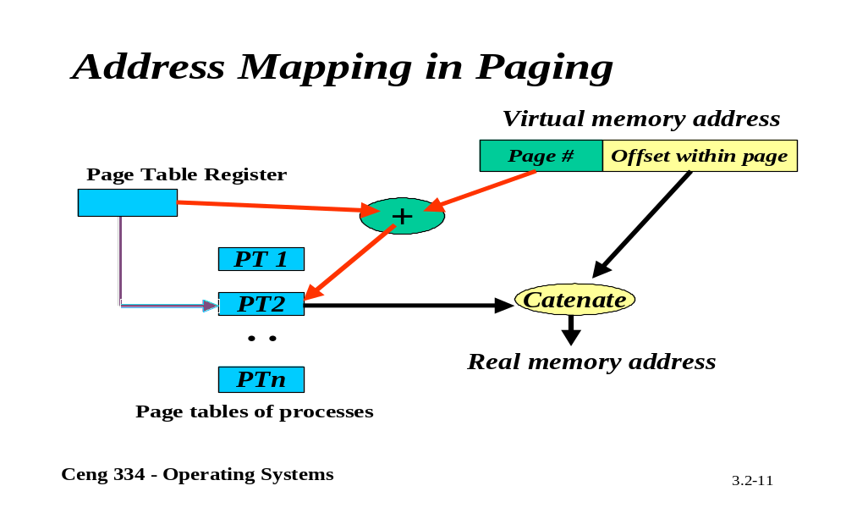
Adrress Mapping

Slide 16
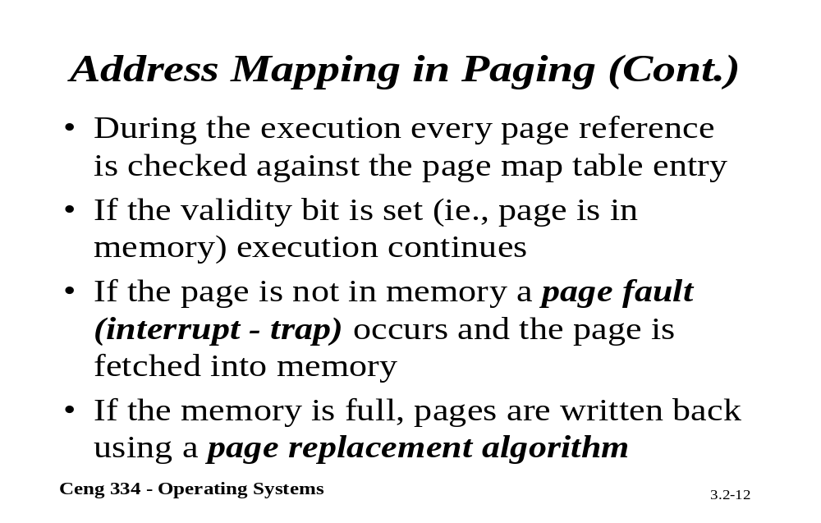
Address Mapping

Slide 17
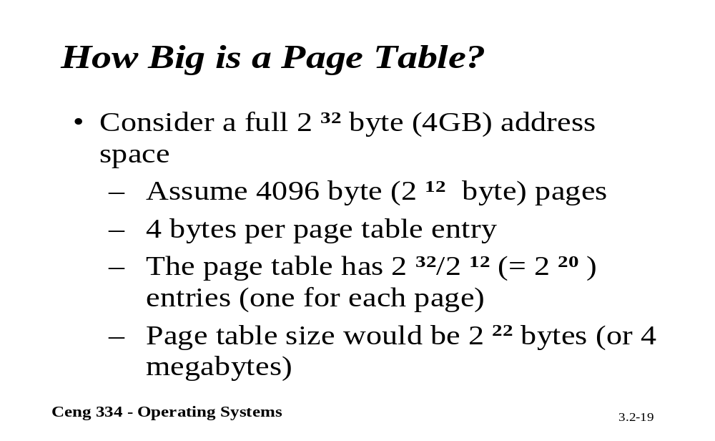
Page Table

Slide 18
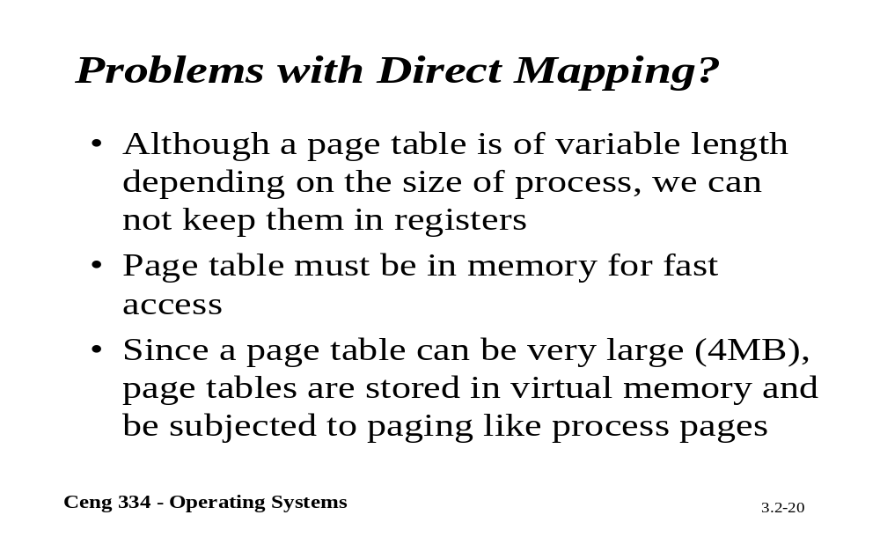
Direct Mapping

Slide 19
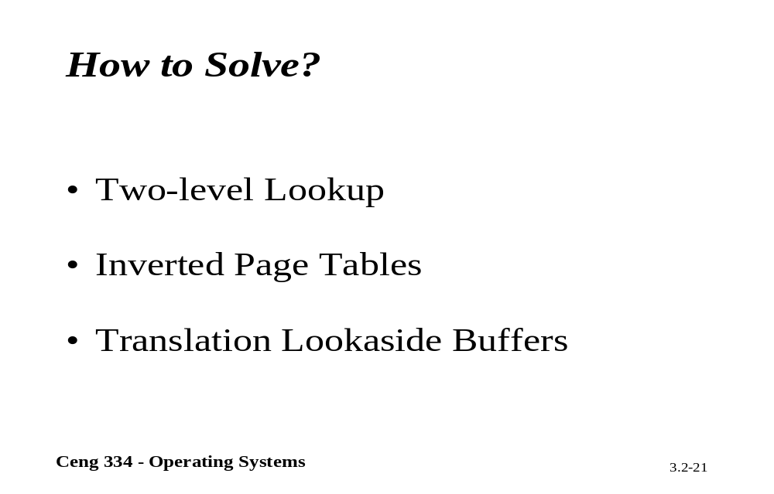
How to Solve?

Slide 20
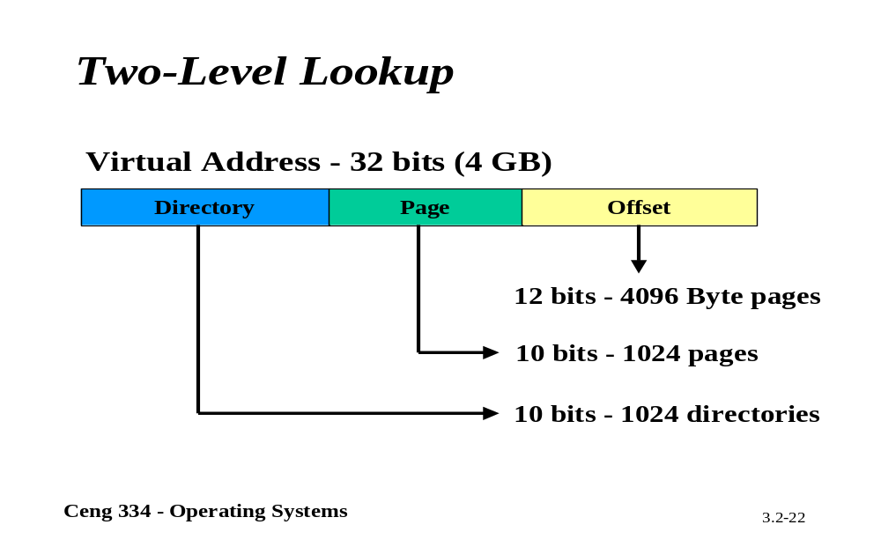
Two-Level Lookup

Slide 21
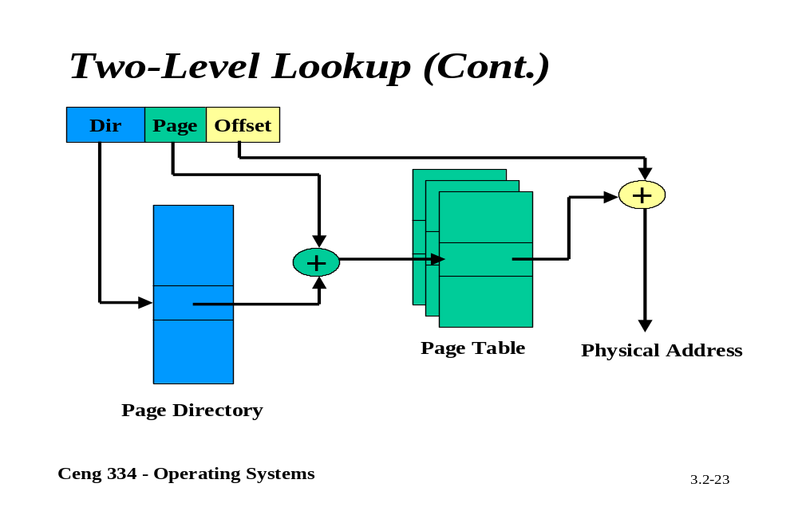
Two-Level Lookup

Slide 22
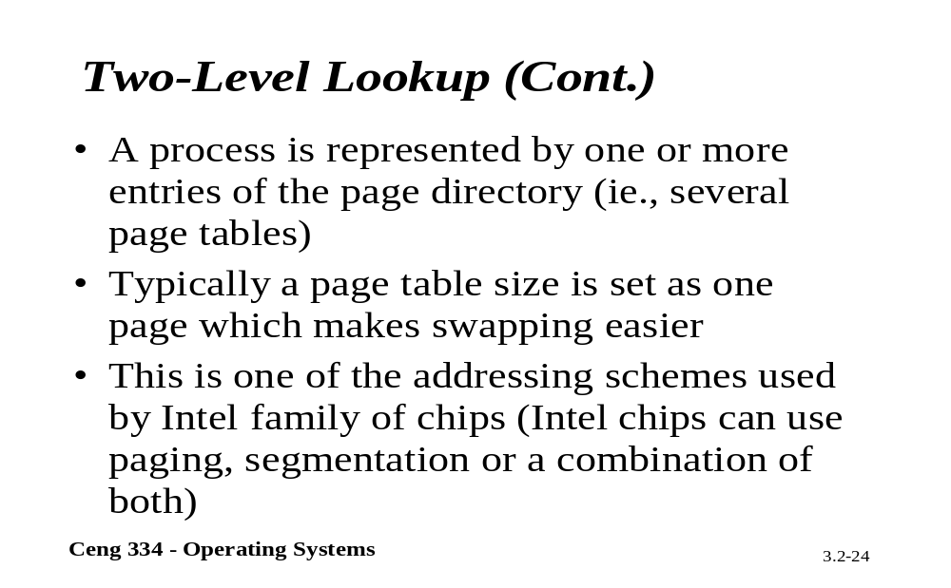
Two-Level Lookup

Slide 23

Page Tables (2)
Second-level page tables
Top-level
page table
32 bit address with 2 page table fields
Two-level page tables

Slide 24

Page Tables (3)
Typical page table entry

Slide 25
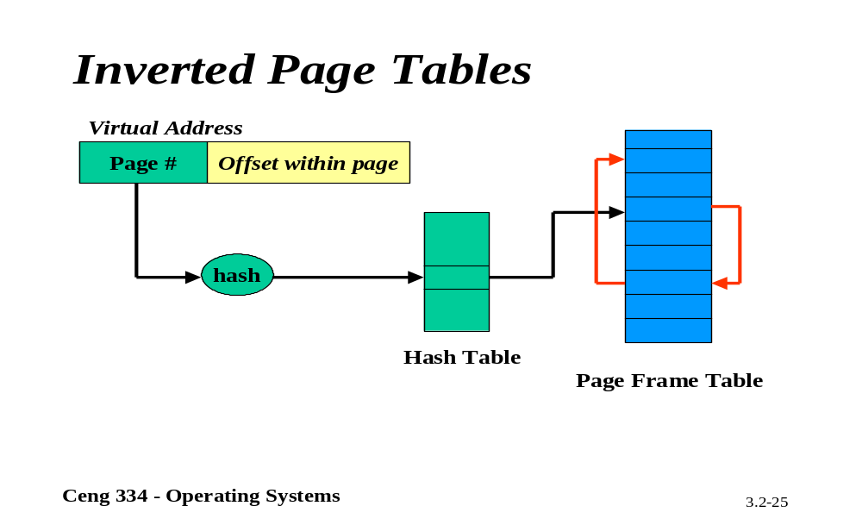
Inverted Page Tables

Slide 26
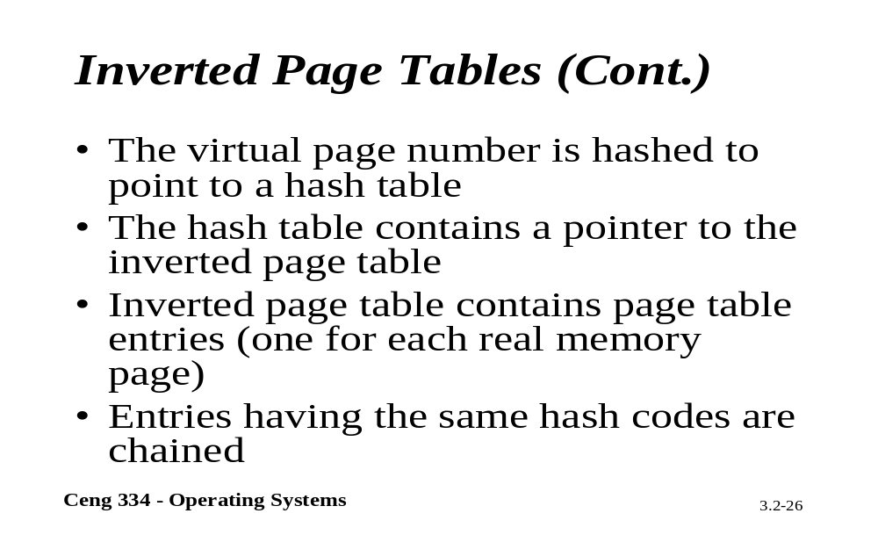
Inverted Page Tables

Slide 27
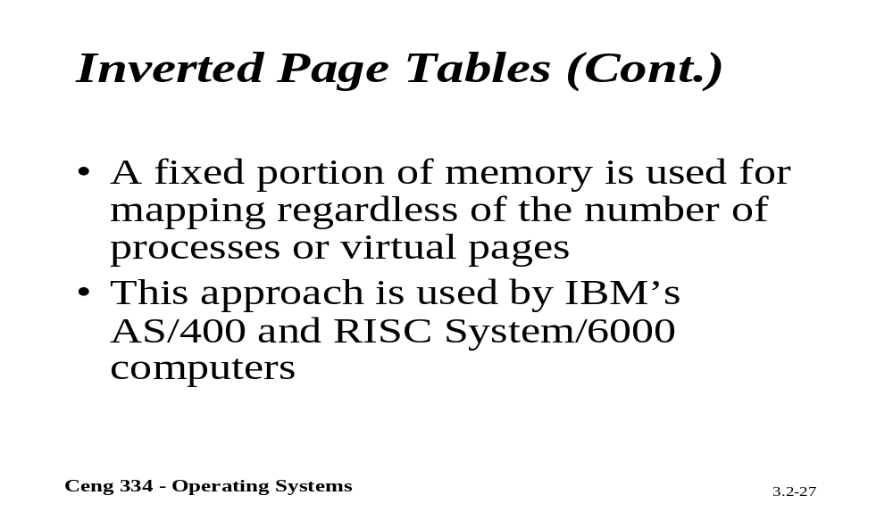
Inverted Page Tables

Slide 28
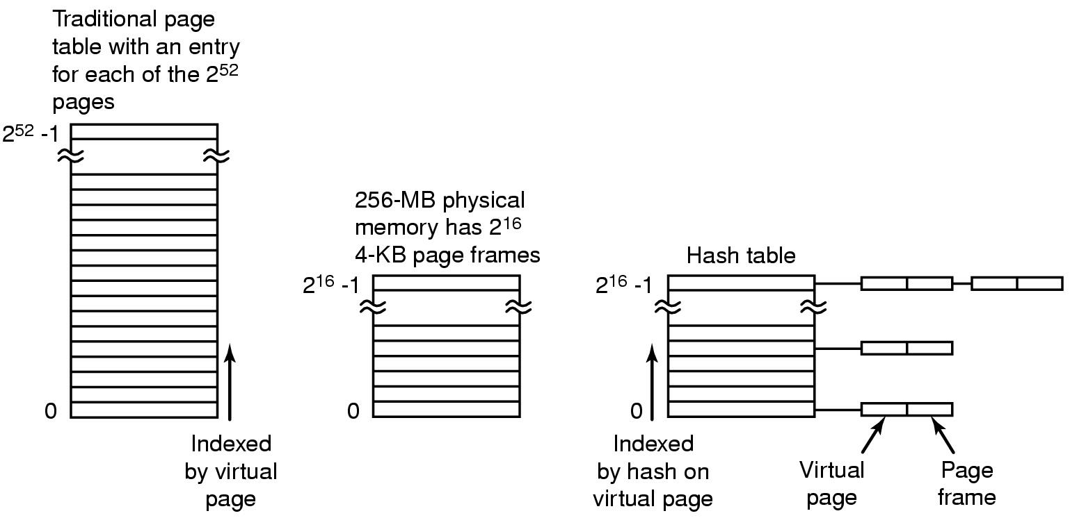
Inverted Page Tables
Comparison of a traditional page table with an inverted page table

Slide 29
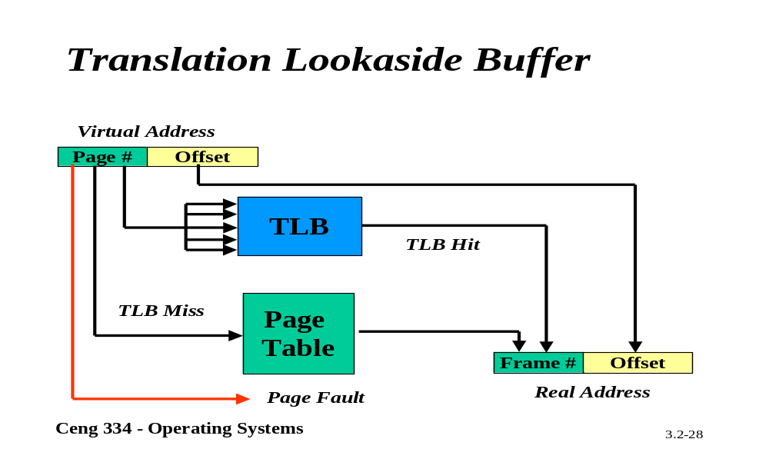
Translation Lookaside Buffer

Slide 30
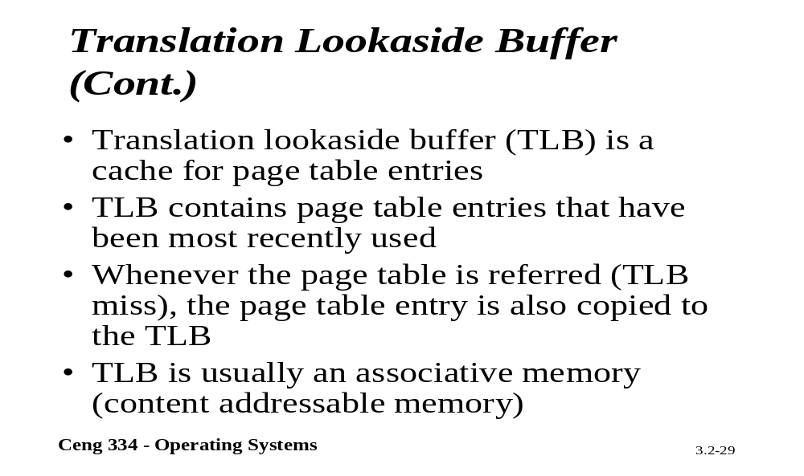
Translation Lookaside Buffer

Slide 31
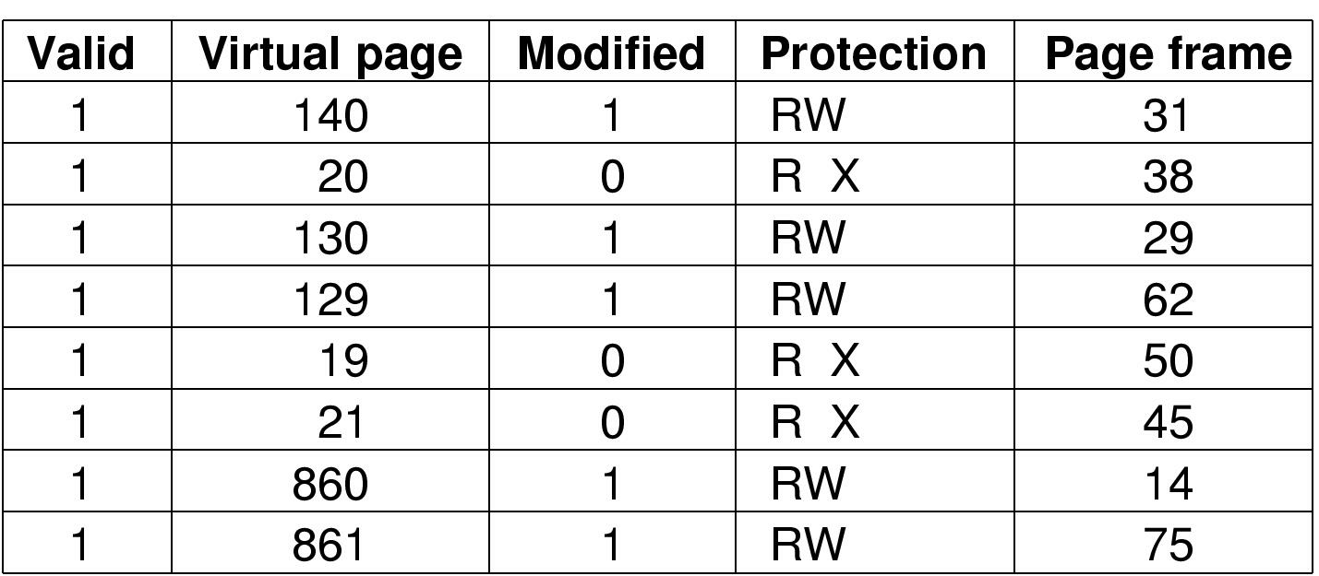
TLBs – Translation Lookaside Buffers
A TLB to speed up paging

Slide 32
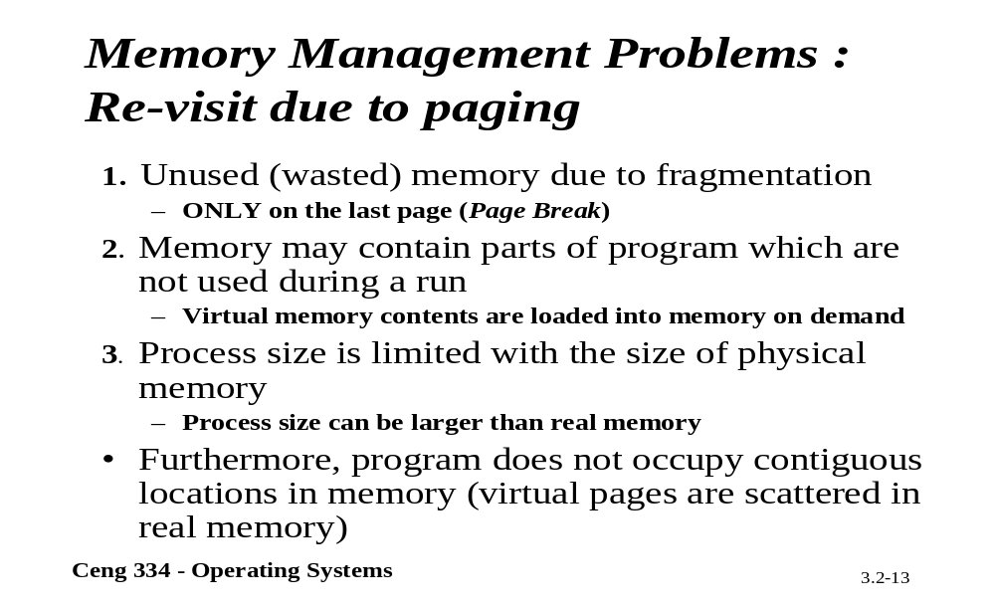
Re-visst Due to Pagging

Slide 33
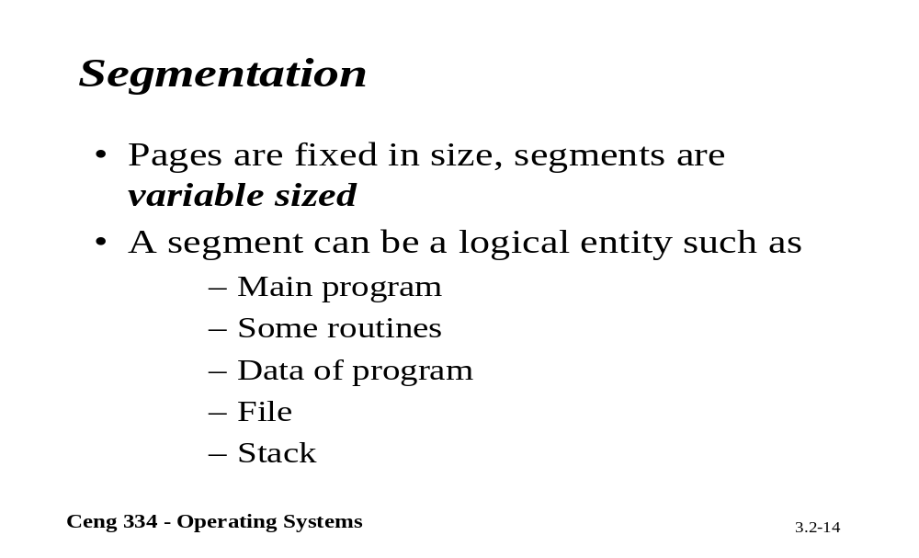
Segmentation

Slide 34
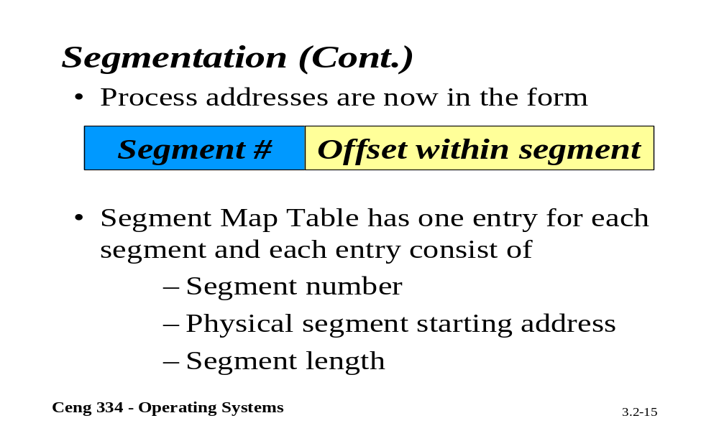
Segmentation

Slide 35

Segmentation (1)
One-dimensional address space with growing tables
One table may bump into another

Slide 36
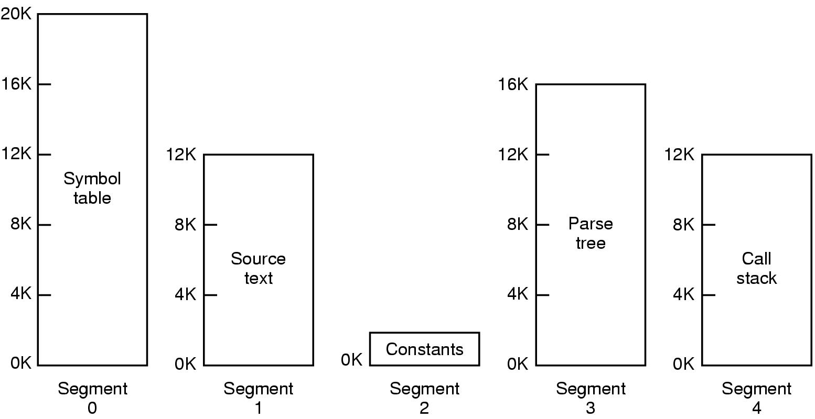
Segmentation (2)
Allows each table to grow or shrink, independently

Slide 37

Segmentation (3)
Comparison of paging and segmentation

Slide 38
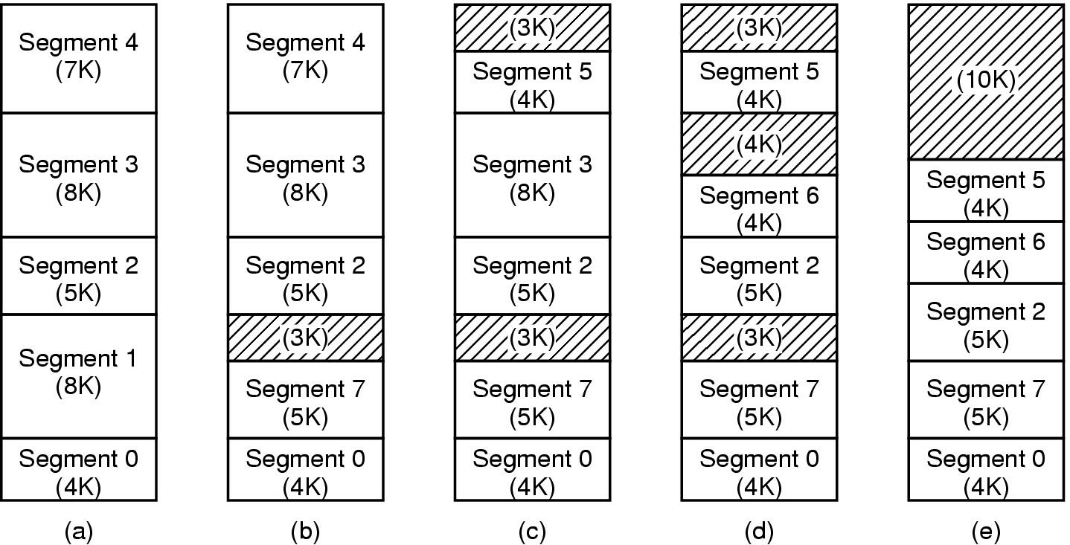
Implementation of Pure Segmentation
(a)-(d) Development of checkerboarding
(e) Removal of the checkerboarding by compaction

Slide 39
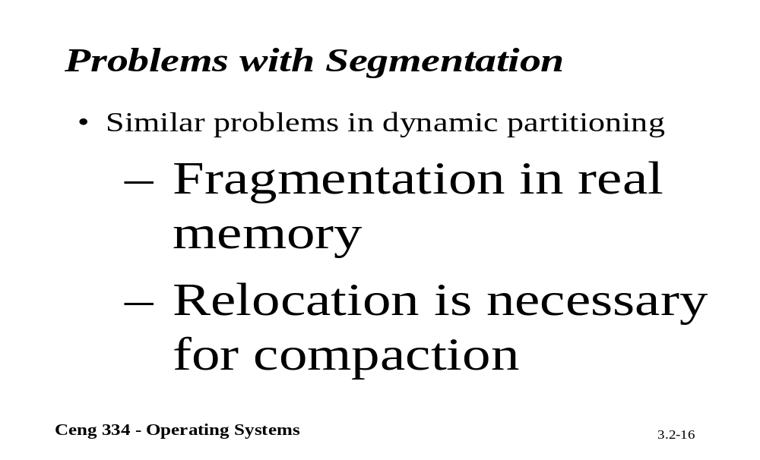
Problems with Segmentation

Slide 40
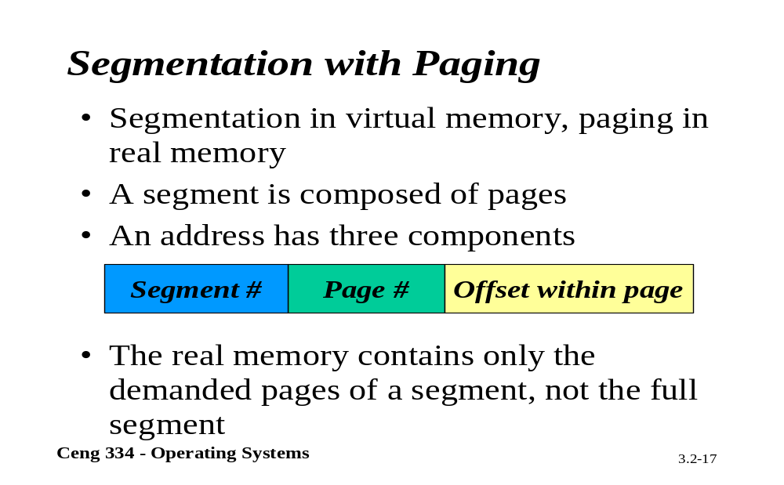
Segmentation with Paging

Slide 41
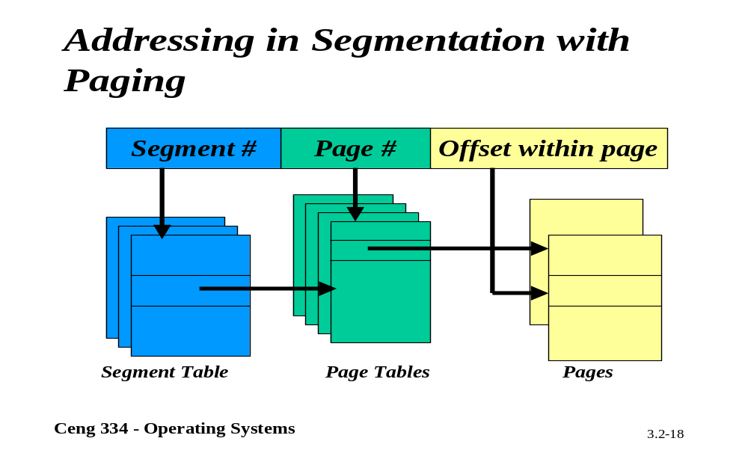
Addressing in Segmentation

Slide 42
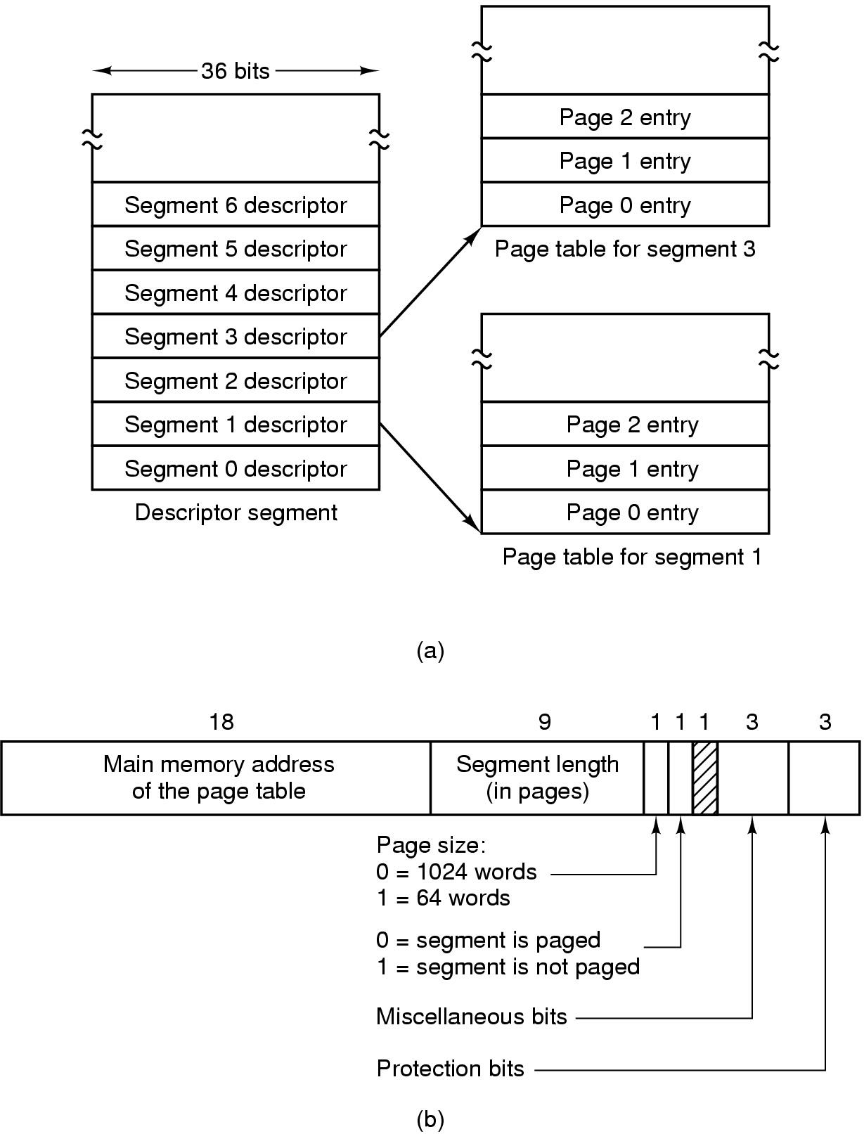
Segmentation with Paging: MULTICS (1)
Descriptor segment points to page tables
Segment descriptor – numbers are field lengths

Slide 43
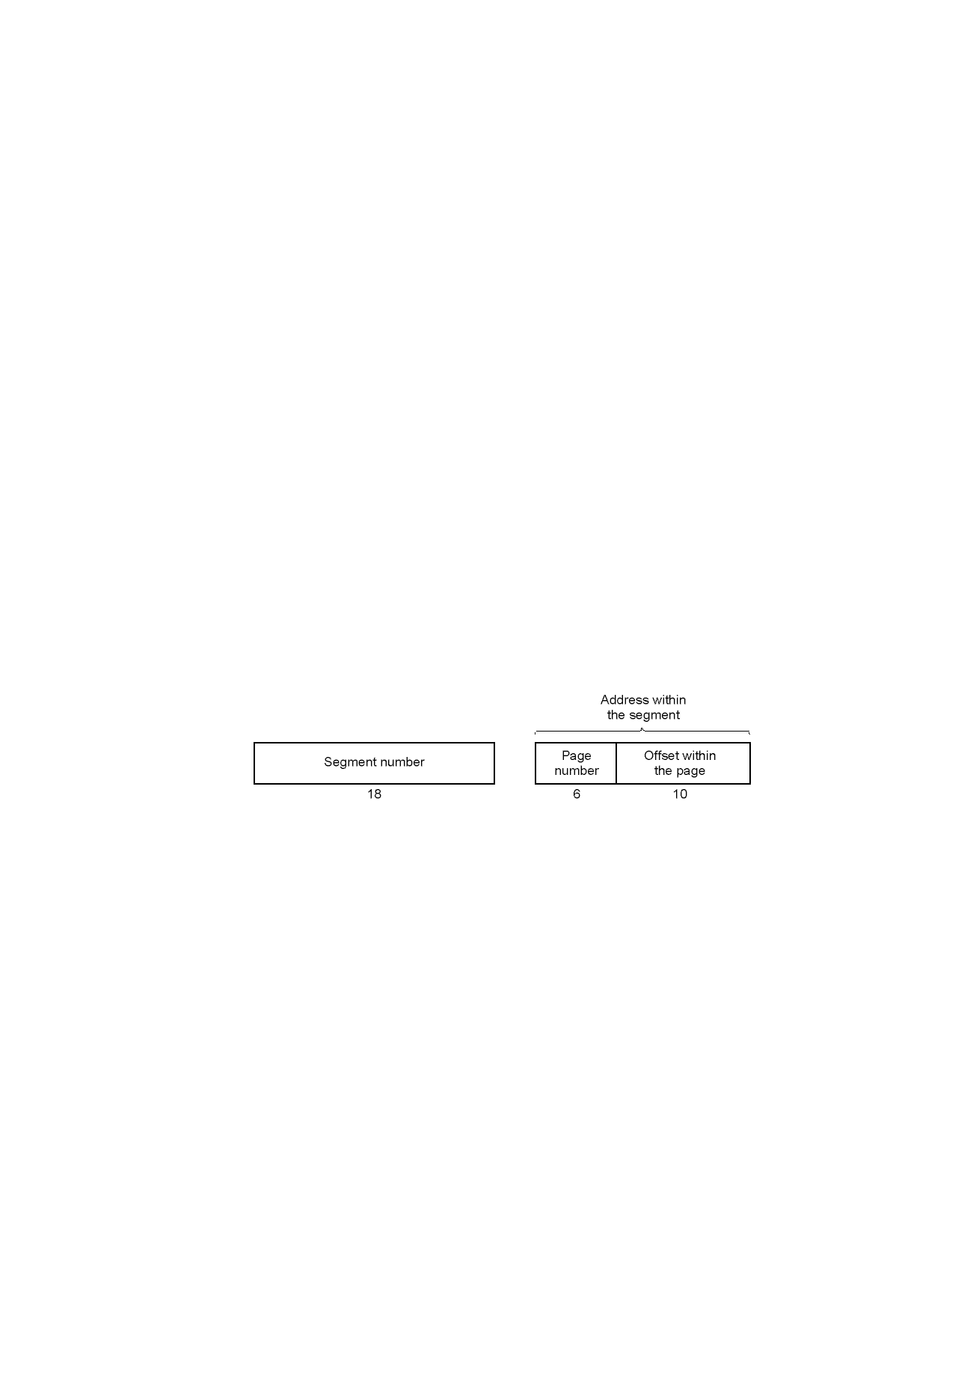
Segmentation with Paging: MULTICS (2)
A 34-bit MULTICS virtual address

Slide 44
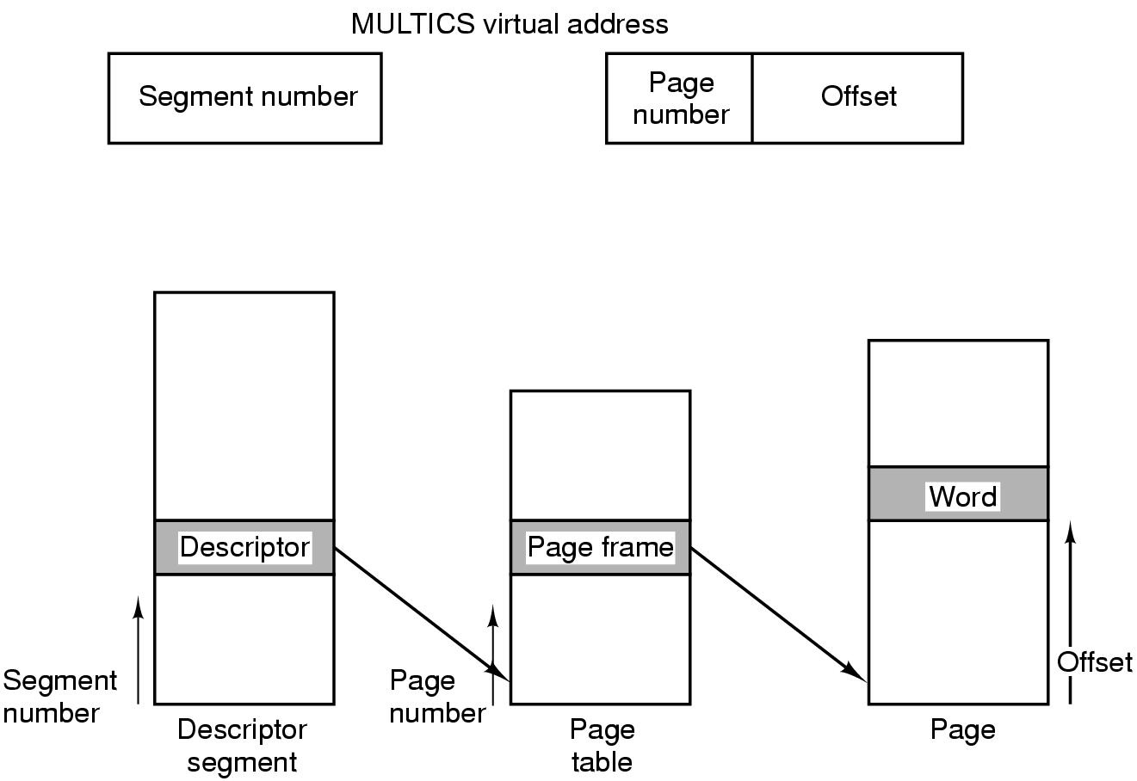
Segmentation with Paging: MULTICS (3)
Conversion of a 2-part MULTICS address into a main memory address

Slide 45
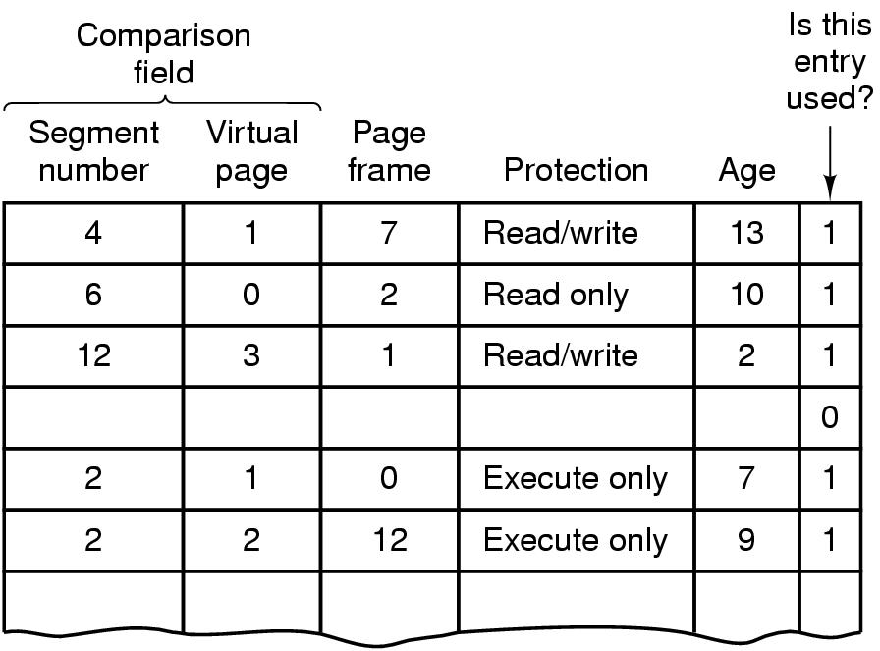
Segmentation with Paging: MULTICS (4)
Simplified version of the MULTICS TLB
Existence of 2 page sizes makes actual TLB more complicated

Slide 46
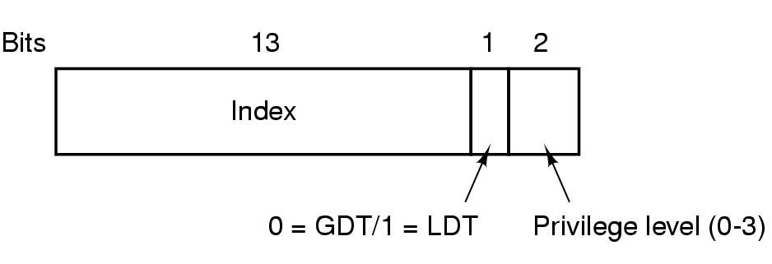
Segmentation with Paging: Pentium (1)
A Pentium selector

Slide 47
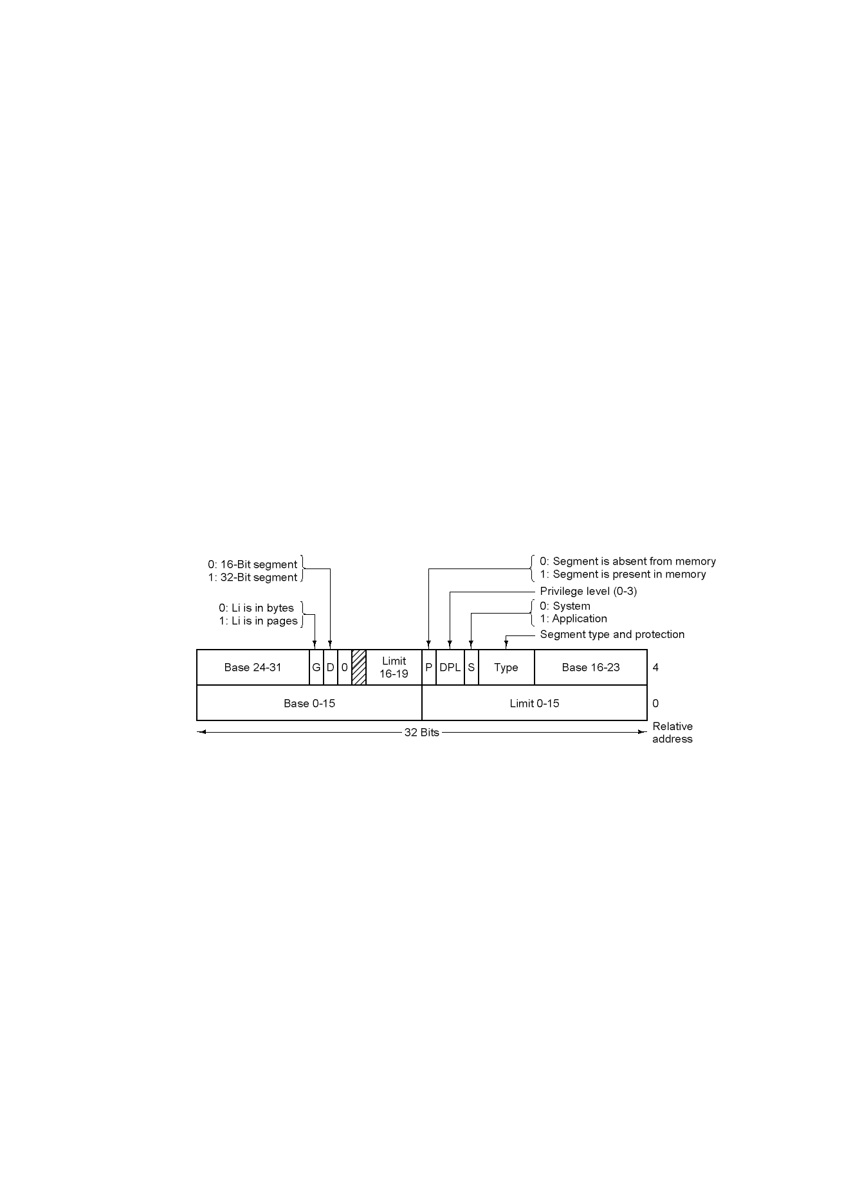
Segmentation with Paging: Pentium (2)
Pentium code segment descriptor
Data segments differ slightly

Slide 48
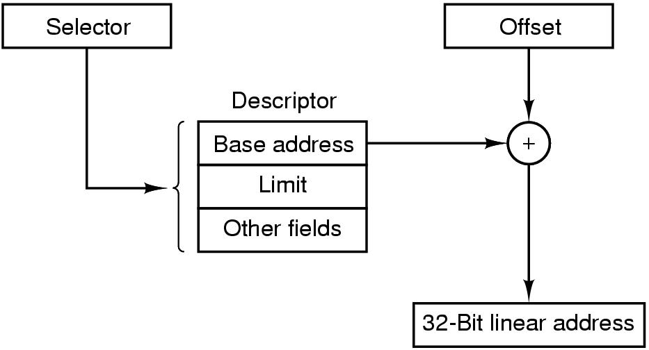
Segmentation with Paging: Pentium (3)
Conversion of a (selector, offset) pair to a linear address

Slide 49
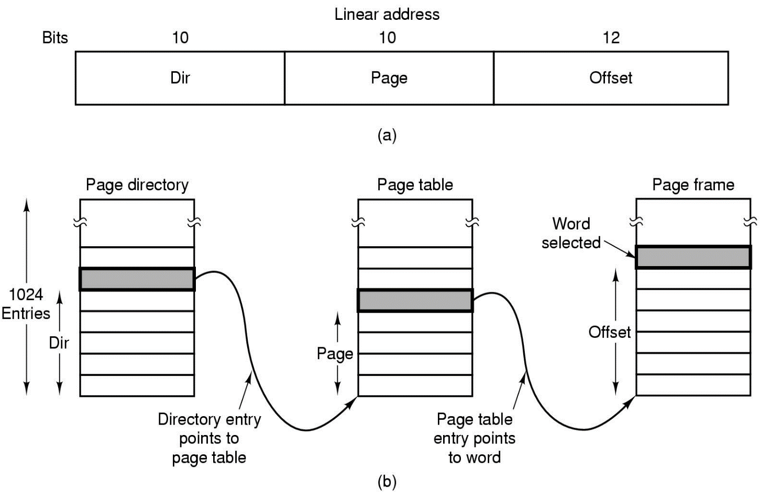
Segmentation with Paging: Pentium (4)
Mapping of a linear address onto a physical address

Slide 50
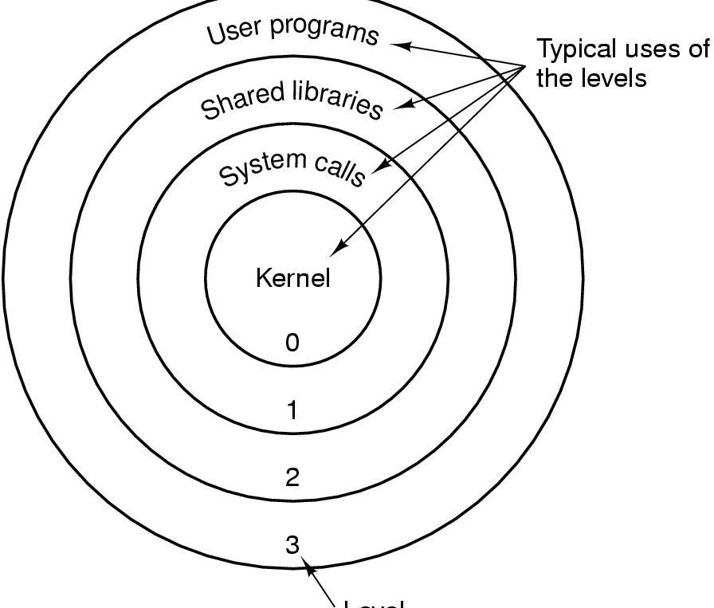
Segmentation with Paging: Pentium (5)
Level
Protection on the Pentium

